Slide 1



A PROJECT BY-
ABHINAV KUMAR (1629119)
SAUBHAGYA ASHISH (1629171)
SHUBHANGI GUPTA (1629176)
SRIPRIYA SRVASTAVA (1629183)
SHEFALI PANDEY (1629191)

Slide 2



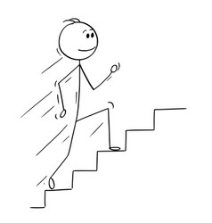
Human Activity Recognition (HAR) aims to identify the actions carried out by a person given a set of observations of him/herself and the surrounding environment. Recognition can be accomplished by exploiting the information retrieved from Smartphone such as sitting, walking, walking upstaires, walking downstairs,laying.

Slide 3

REQUIREMENT ANALYSIS AND SPECIFICATION
Software Used -
Anaconda - Anaconda is an open source free platform for Python and R programming languages for scientific use i.e., applications for machine learning,data science,predictive analytic,etc. It is equipped with more than 1,500 packages along with virtual environment. It is basically acts as an environment manager.
Ecllipse - Eclipse is a platform which is an integrated development environment used in computer languages specifically in Java SE.It was developed by Eclipse foundation.It uses several programming languages such as Java programming language,C/C++,Python,Ruby,Pearl etc.It has feature which offer tools such as code formatting,auto completion,type error reporting etc.
SQL - SQL stands for Structured Query Language. It is designed for managing data in a relational database management system (RDBMS).

Slide 4
Algorithm Used -
SVM - In machine learning, support-vector machines are supervised learning models with associated learning algorithms that analyze data used for classification and regression analysis.
k-NN - In K-Nearest Neighbour classification, the output is a class membership. An object is classified by a plurality vote of its K-neighbors, with the object being assigned to the class most common among its k nearest neighbors (k is a positive integer, typically small).
Logistic Regression- Logistic regression is a regression model. The model builds a regression model to predict the probability that a given data entry belongs to the category numbered as “1”. Logistic regression is a classification algorithm, it is used to discriminate value like binary values(0,1) or true or false.
Random Forest- Random forest classifier creates a set of decision trees from randomly selected subset of training set. It then aggregates the votes from different decision trees to decide the final class of the test object.

Slide 5
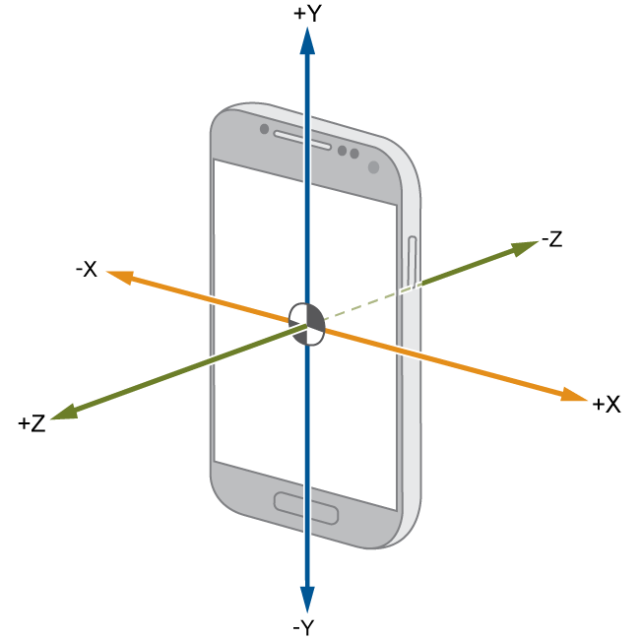
Sensors Used
Acellerometer- An accelerometer is a device that measures proper acceleration. Proper acceleration, being the acceleration of a body in its own instantaneous rest frame, is not the same as coordinate acceleration, being the acceleration in a fixed coordinate system. In short it an instrument for measuring the acceleration of a moving or vibrating body.
Gyroscope- It is a devices that sense angular velocity. Angular velocity. In simple terms, angular velocity is the change in rotational angle per unit of time. Angular velocity is generally expressed in deg/s (degrees per second).The gyroscope, adds an additional dimension to the information supplied by the accelerometer by tracking rotation or twist.

Slide 6
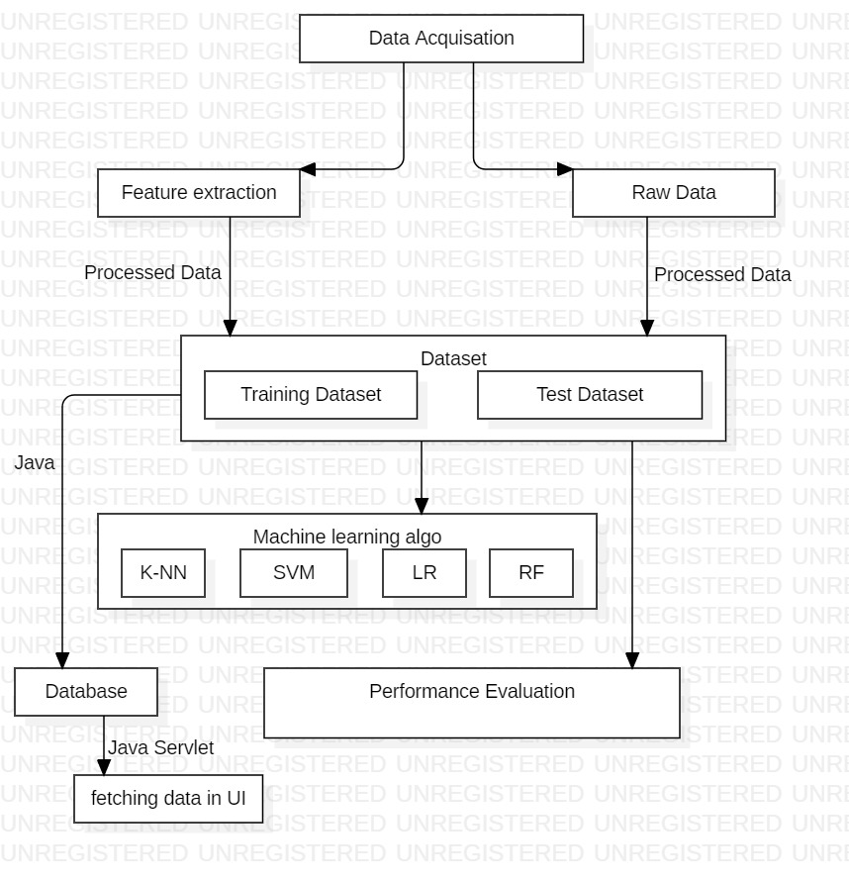
SYSTEM DESIGN

Slide 7
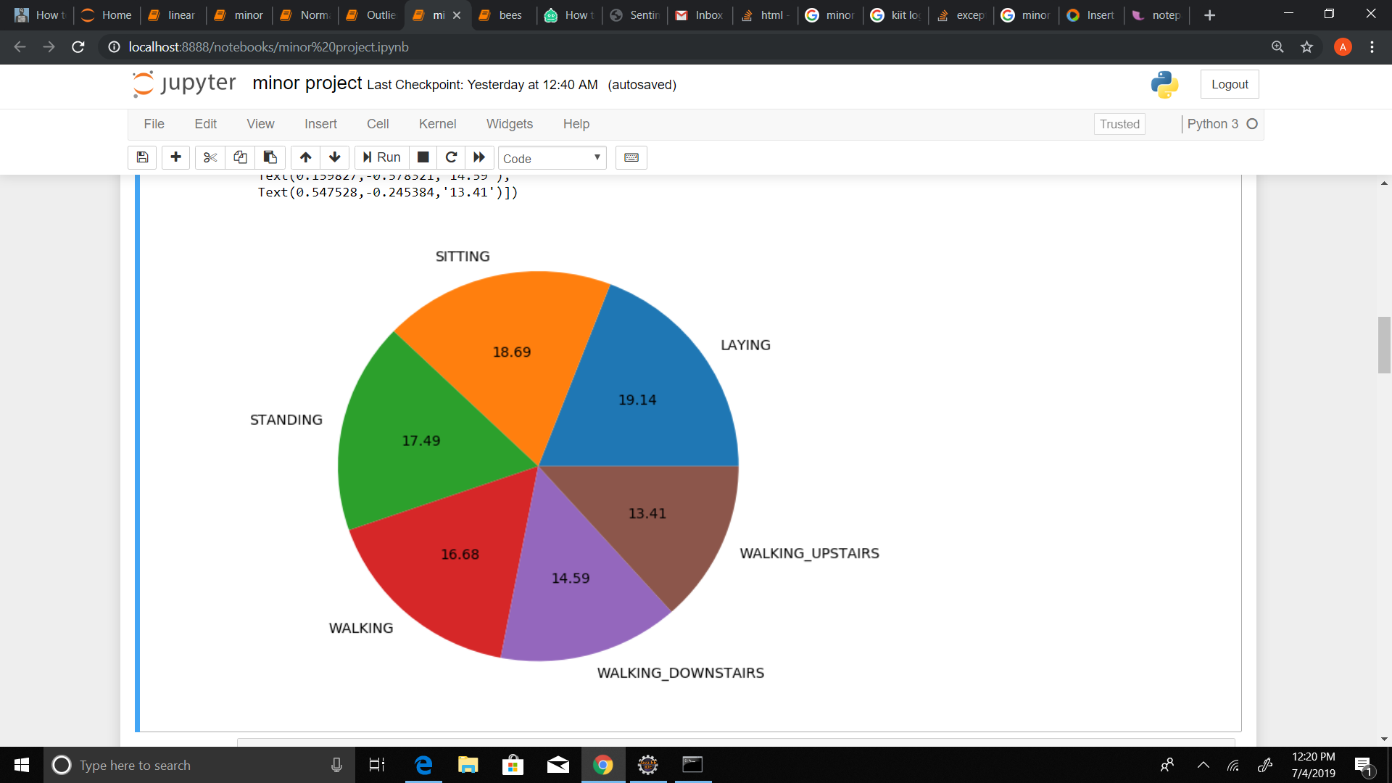
SCREENSHOTS-
Pi- chart

Slide 8
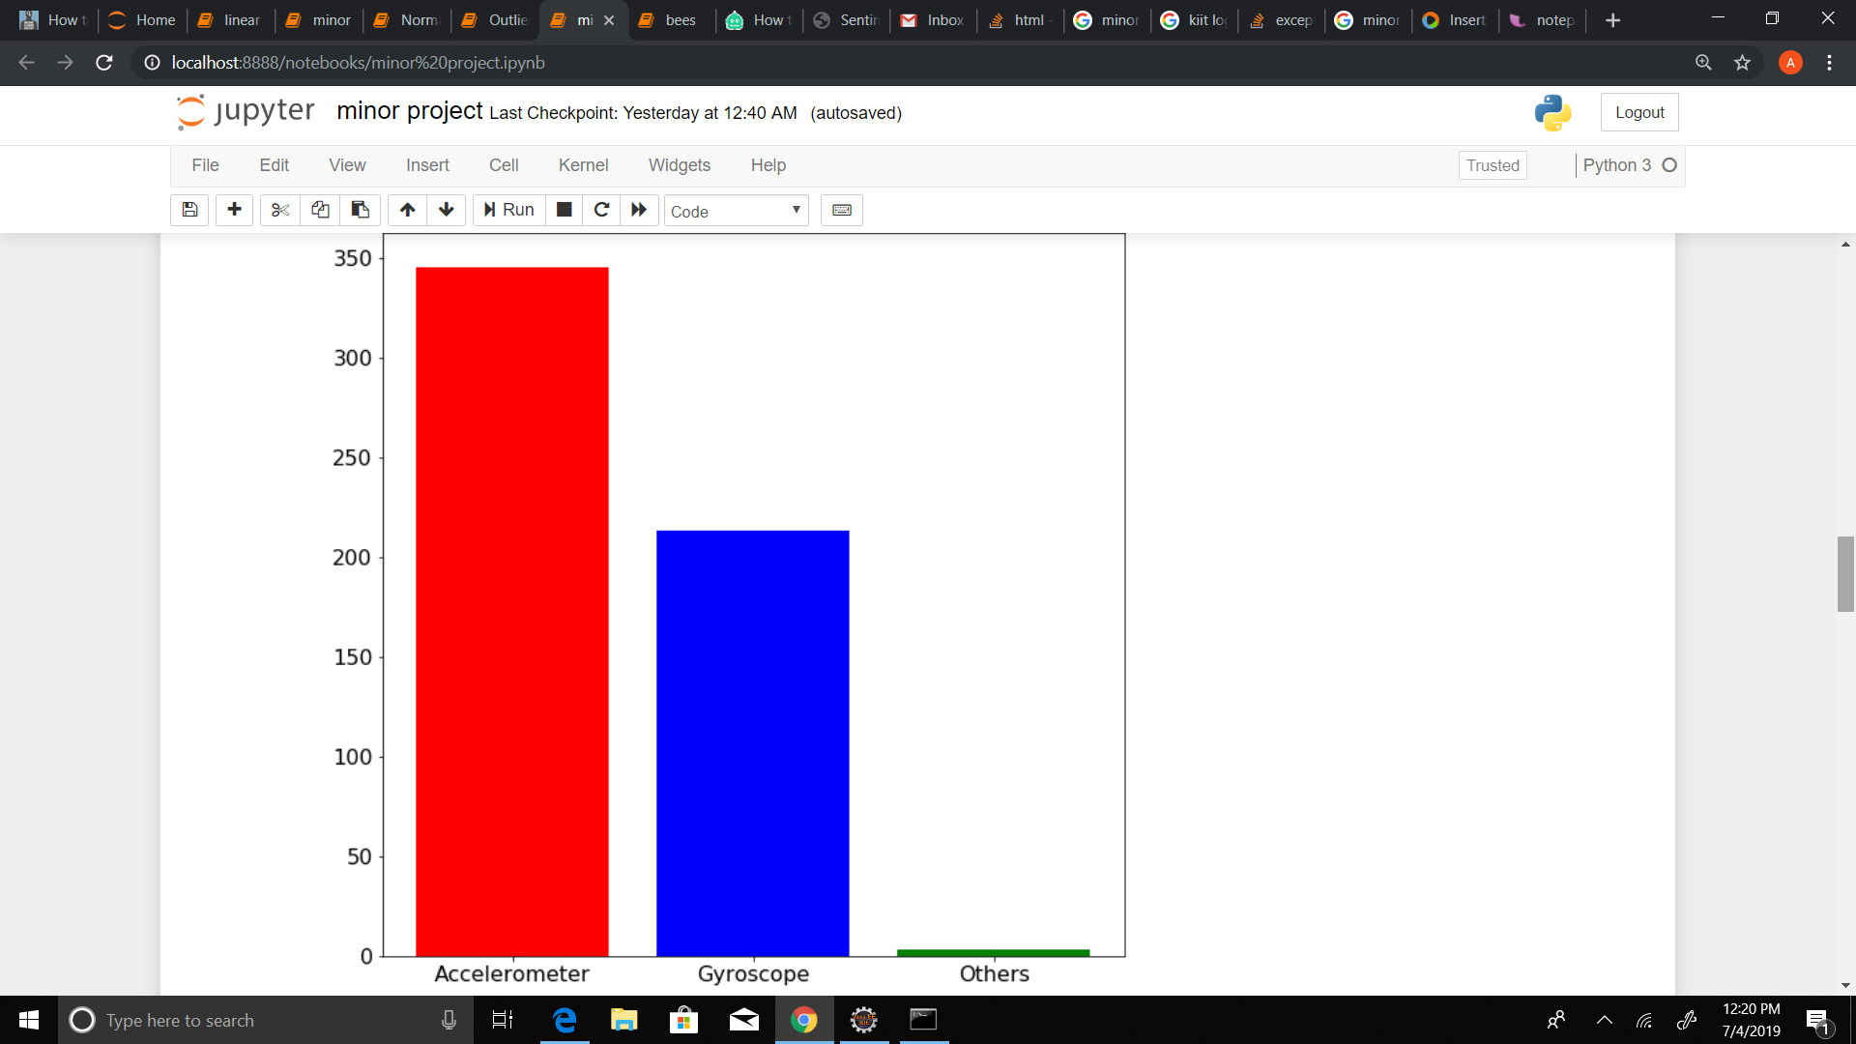
Bar Graph

Slide 9
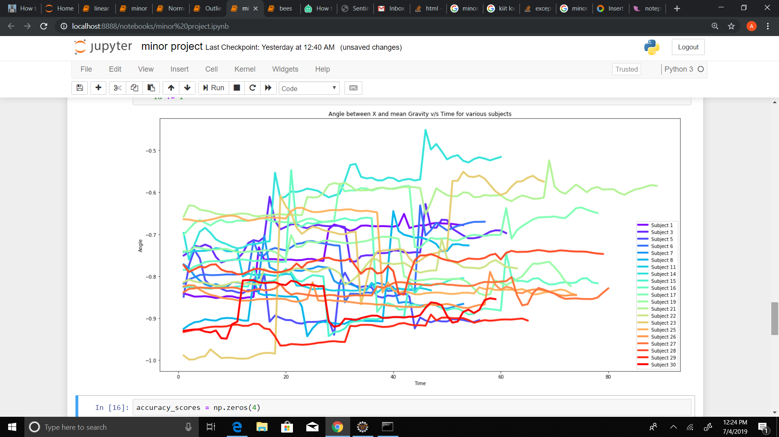
Angle between X and mean Gravity v/s Time for various subjects

Slide 10
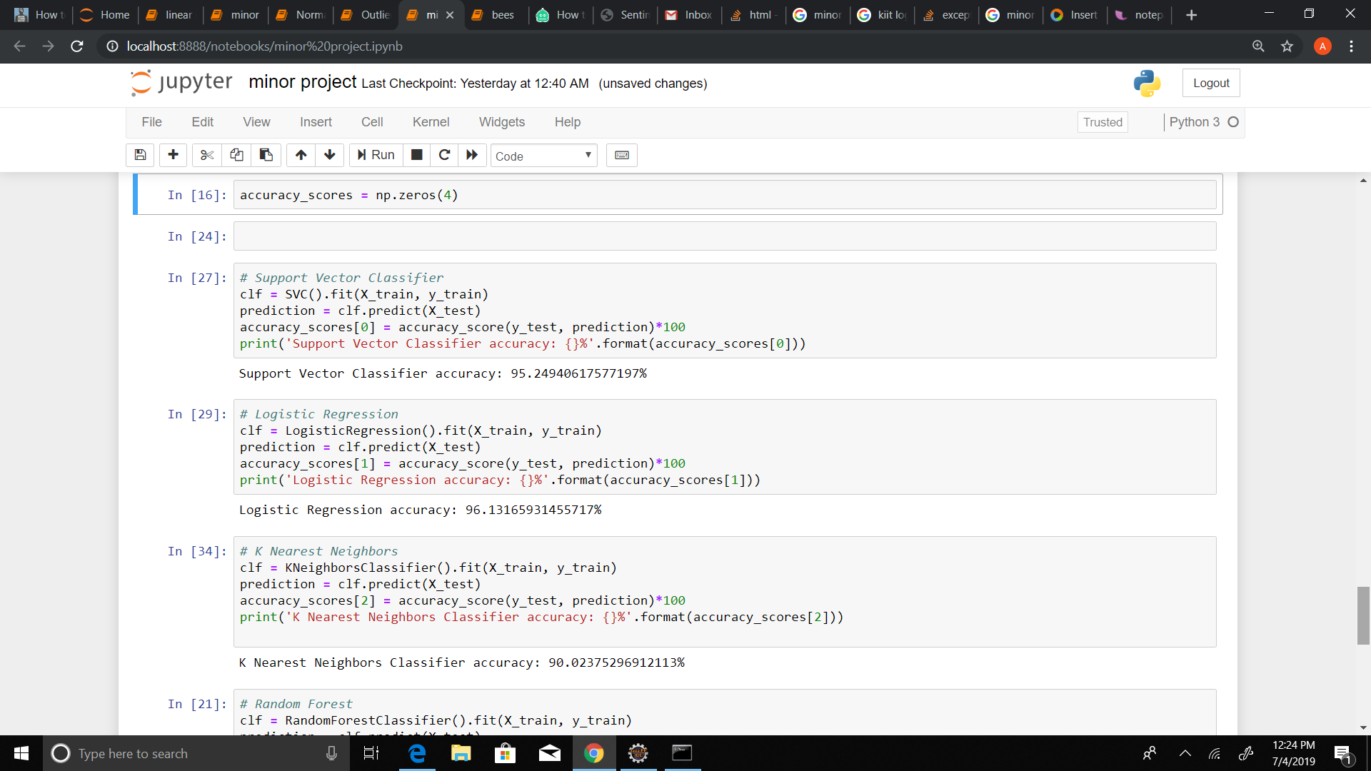
Algorithms-

Slide 11
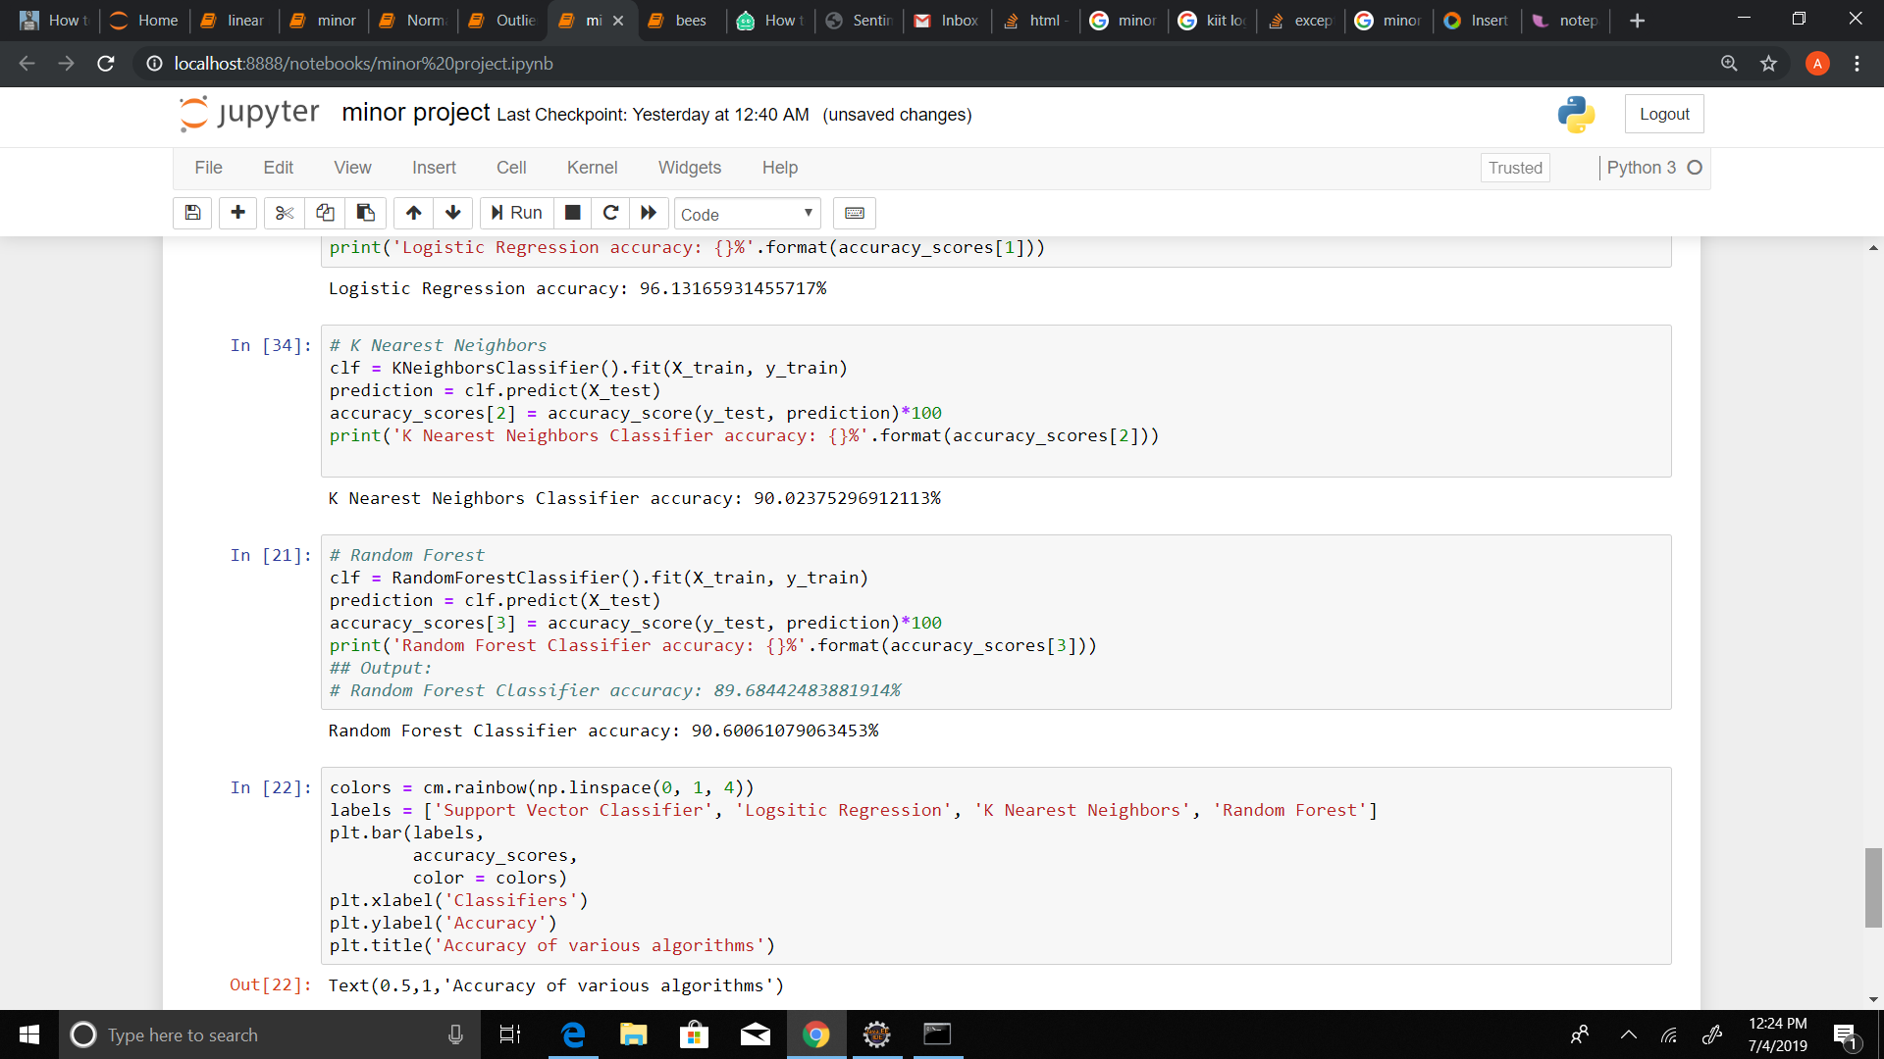

Slide 12
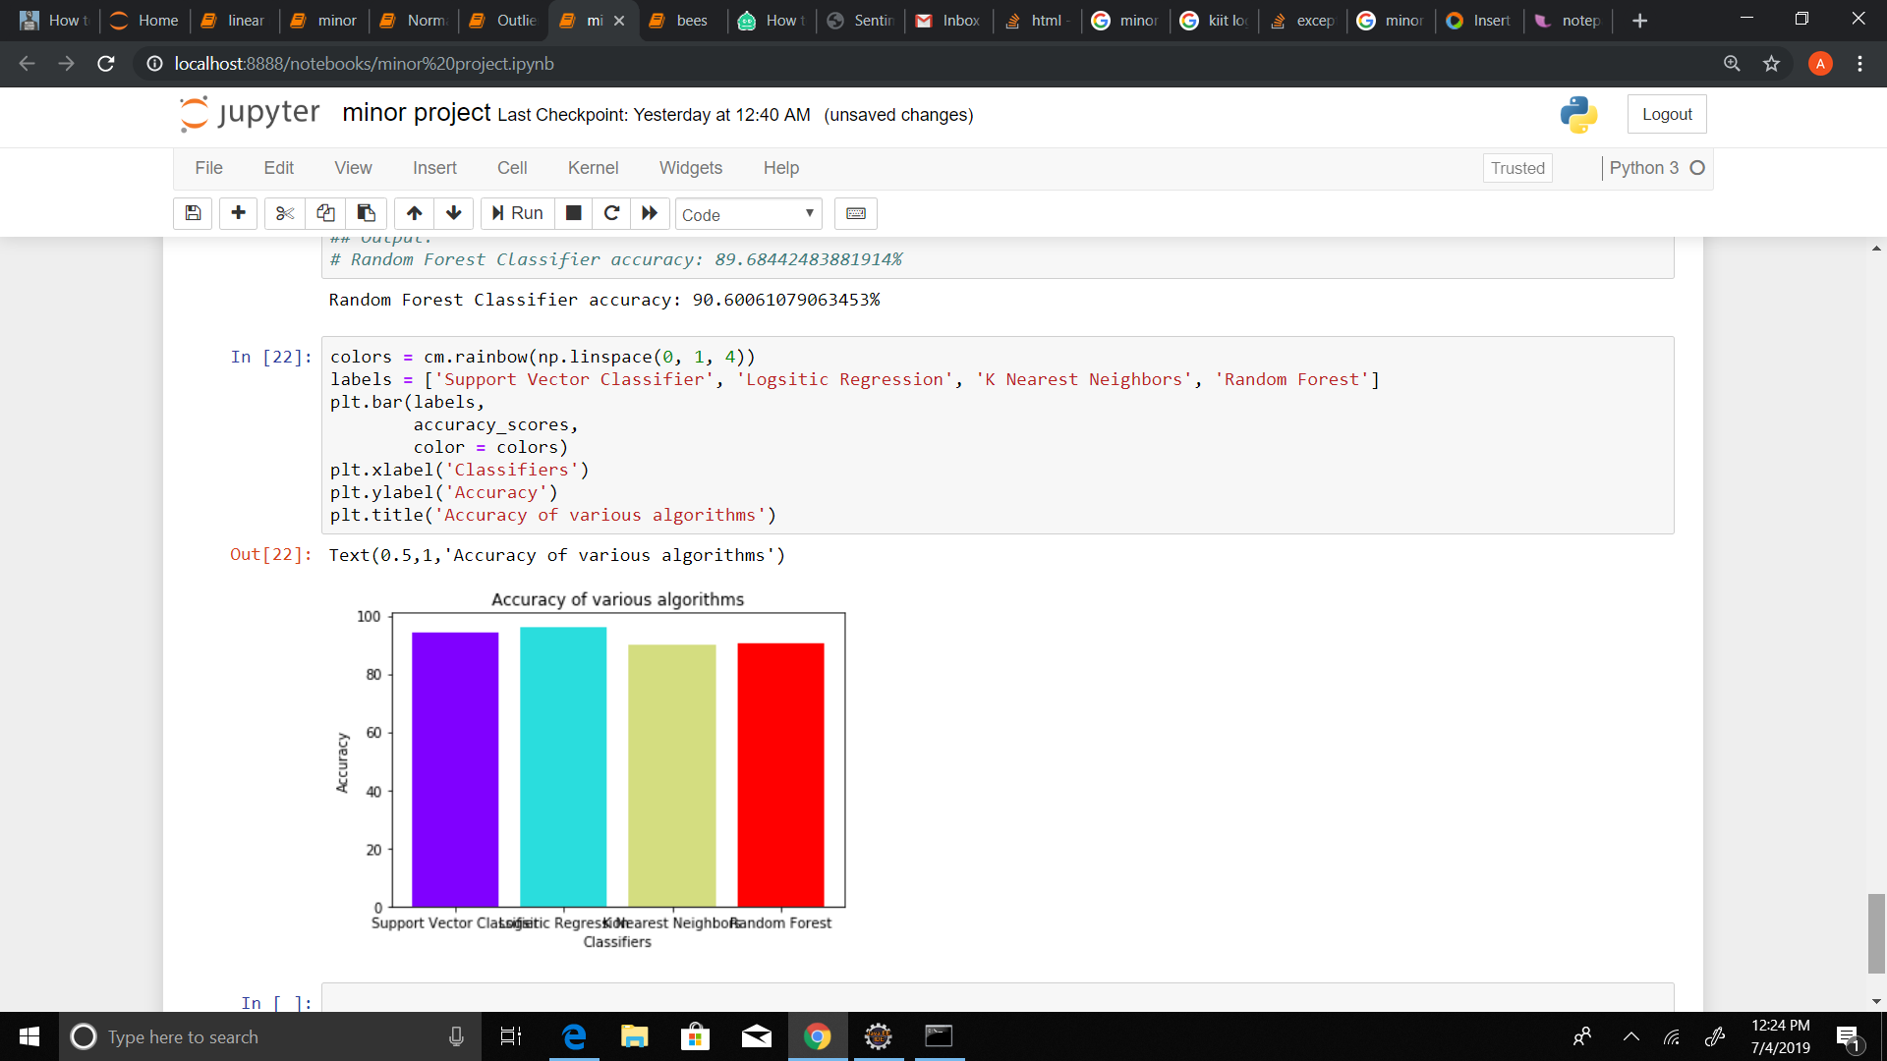
Alogorithm and Accuracy-

Slide 13
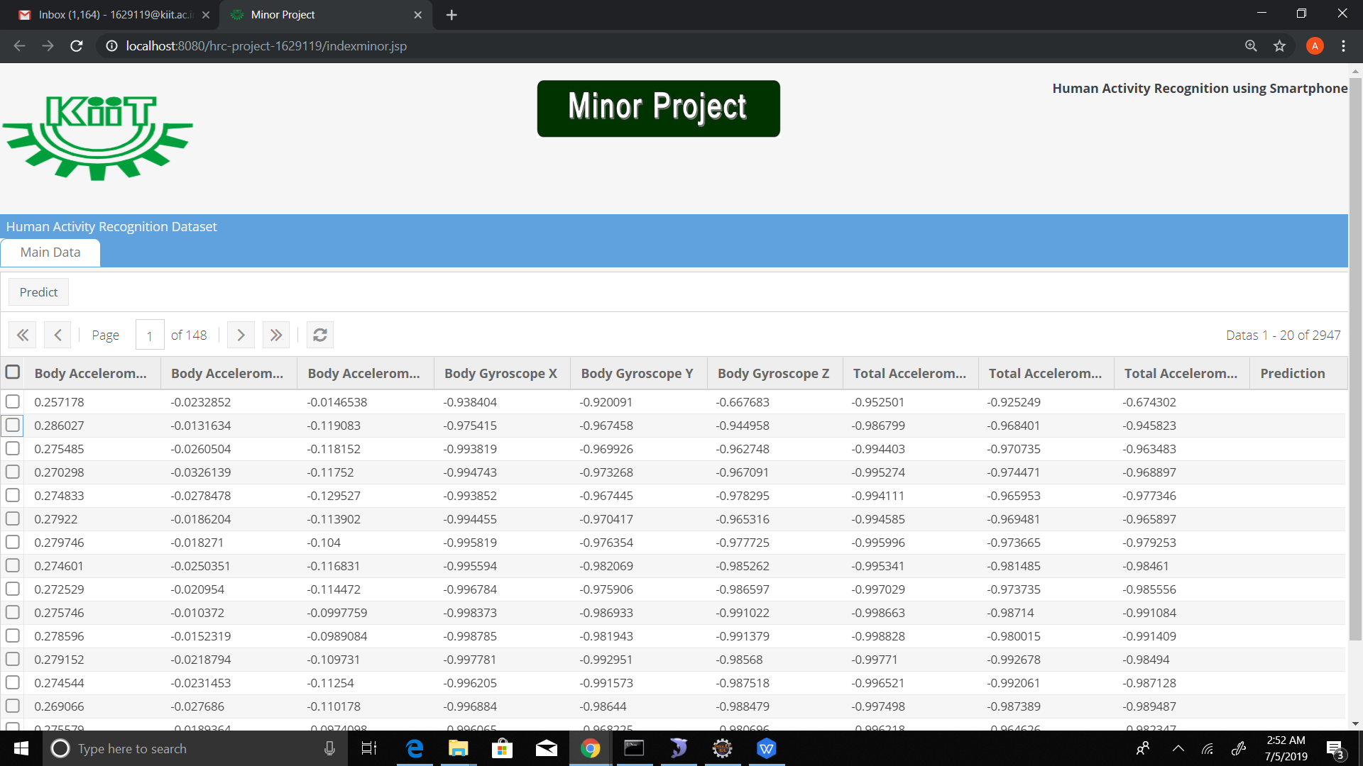
FRONT END

Slide 14
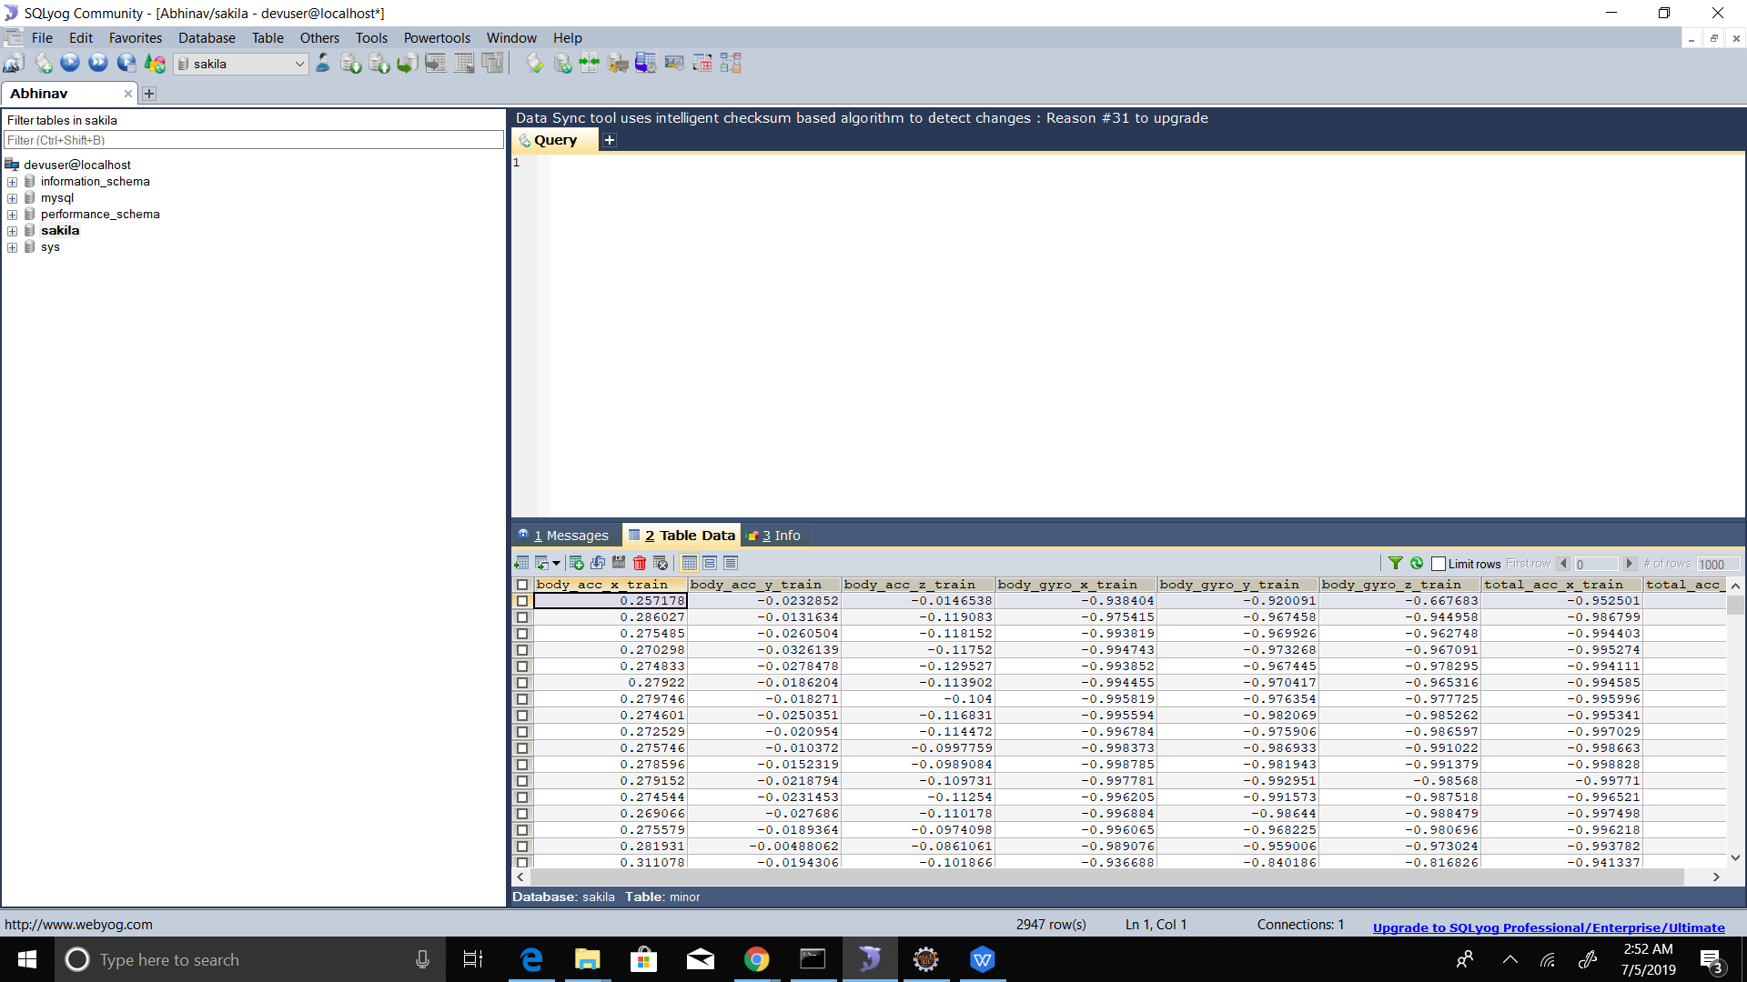
Back-end -

Slide 15

CONCLUSION
Need of understanding human activities has intrigued demands in the new era technology.It has broad applications in various fields such as medical arena or survey system which needs to be mentioned thoroughly.
In this project,a smartphone-based recognition system is designed which provides assistance in monitoring various human activities such as :-
Standing
Walking
Walking upstairs
Walking downstairs
Sitting,Laying
It is designed to assist the health-care domain to a great extent.The concept of smartphones as low costs sensor to identify human activities is used in this project.
Conclusively,logistic regression is the optimal solution to our problem.It gives the best performance and is promising to run on smartphones.

Slide 16
FUTURE SCOPE Human activity recognition tends to be an important aspect in the AI and ML field.Numerous facts,deliberate efforts have been put up in establishing the very important assets of this very recognition.In computer mission,it can act as a basis for many applications including health-care surveillance and human-computer relationship.Various technologies have been developed and it is still updating.Still it faces various challenges when handling realistic approaches.It has to be tackled deliberately in order to achieve the maximum potential.The use of Human Activity Recognition using smartphones can add up to several vital applications which can tremendously benefit the future scenario.

Slide 17
THANKS

